Slide 1
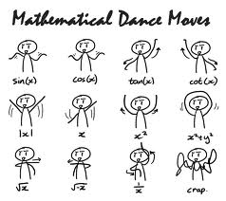
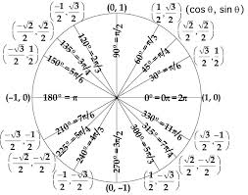
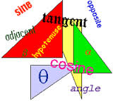
TRIGONOMETRY
UNIT 2
Jose A.
Per. 1

Slide 2
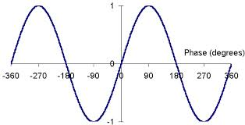
Properties:
Sinusoid: a function that can be written in the form: f(x)=a sin(b(x-h))+k or f(x)=a cos (b(x-h))+k. h is the phase shift.

Slide 3
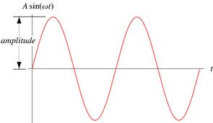
Amplitude:
The amplitude is half of the difference between the minimum and maximum values of the range.(it is the radius of the range.)

Slide 4
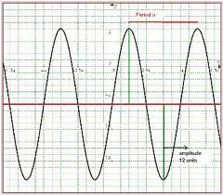
Period:
The period of a wave is the time that it takes for the wave to complete one cycle.

Slide 5
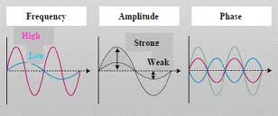
Frequency and Phase:
The frequency of a graph is the number of complete cycles that happen.
The phase is the fraction of the point that you have reached at a certain time.

Slide 6
Example:

Slide 7
TRIGONOMETRIC FUNCTIONS AND THEIR INVERSE WITH THE UNIT CIRCLE:
sin(t) = y,
cos(t) = x,
tan(t) = y/x so long as x is not 0,
csc(t) = 1/y, so long as y is not 0,
sec(t) = 1/x so long as x is not 0,
cot(t) = x/y so long as y is not 0

